Slide 1

Tumor Cell Nuclei Analysis
By: Nathanael Ochoa
DSC680 - Project 3
March 1, 2025

Slide 2
Background History
Research Questions
Dataset sourced from UC Irvine Machine Learning Repository.
Study conducted in 1992 aimed at diagnosing breast tumors without full biopsies.
Fine needle aspirations (FNAs) and image processing techniques used.
Can tumor cell nuclei characteristics predict tumor malignancy?
Which variables are most significant for distinguishing between benign and malignant tumors?
How accurate can a predictive model be?

Slide 3
Data Explanation
Data Preparation
32 variables in the dataset
One target variable (benign/malignant)
Focus on tumor cell nuclei characteristics
Checked for null values
Dropped unnecessary ‘id’ column
Created a binary target column: ‘d_bool’ (benign or malignant)

Slide 4
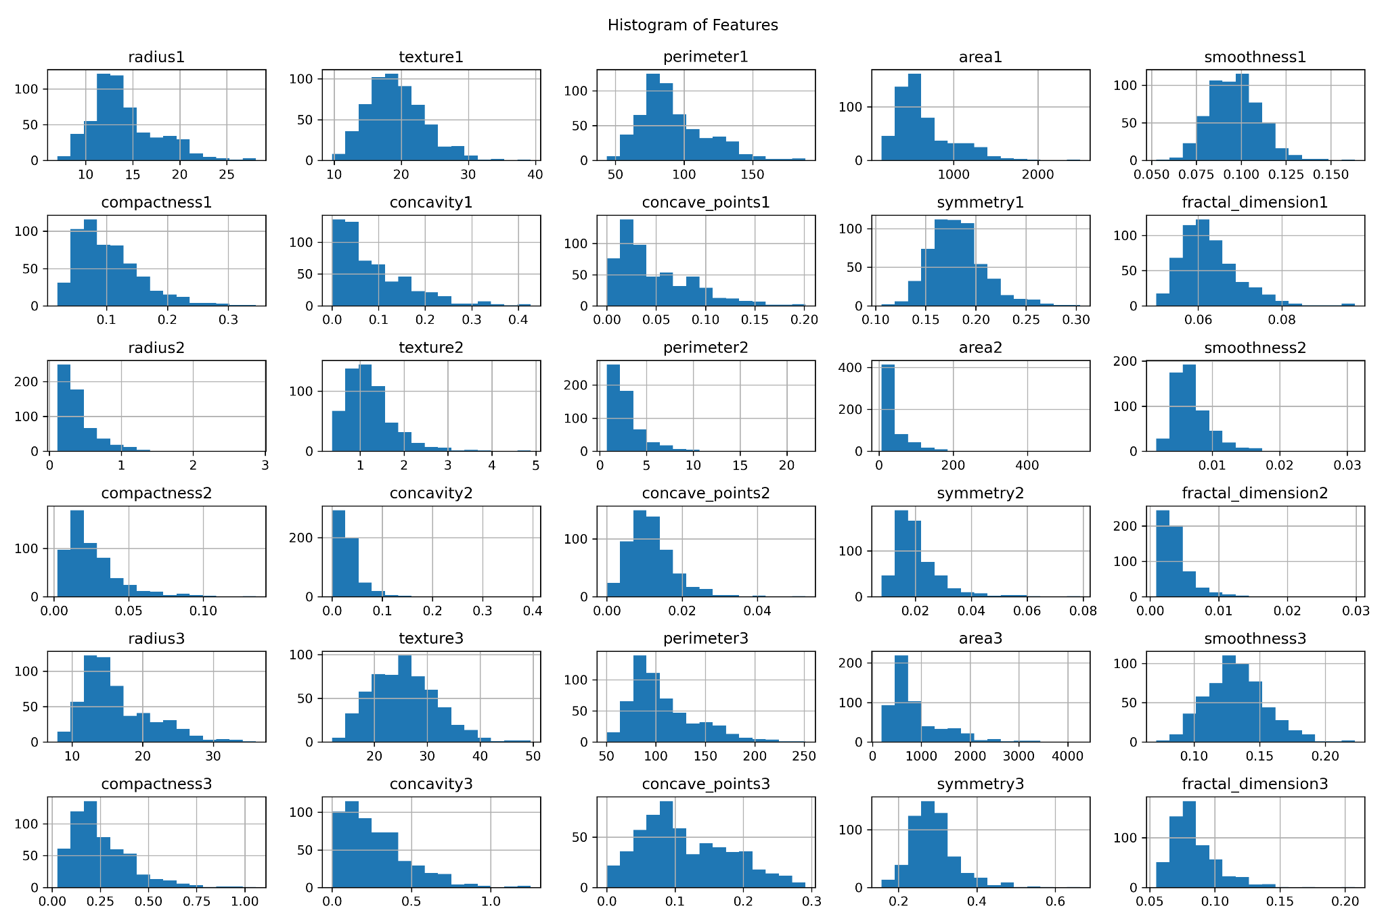
Exploratory Data Analysis (EDA)
Visualized target variable distribution (countplot)
Univariate analysis using histograms for key features
Shows a decent distribution, but overall, the values tend to be on the smaller end, which is expected
Correlation matrix to find relationships with target variable

Slide 5
Model Building
Applied feature scaling and train-test splits (80/20, 70/30)
Tested three models: Logistic Regression, Random Forest, and Support Vector Machine (SVM)
Used 5-fold cross-validation for logistic regression

Slide 6
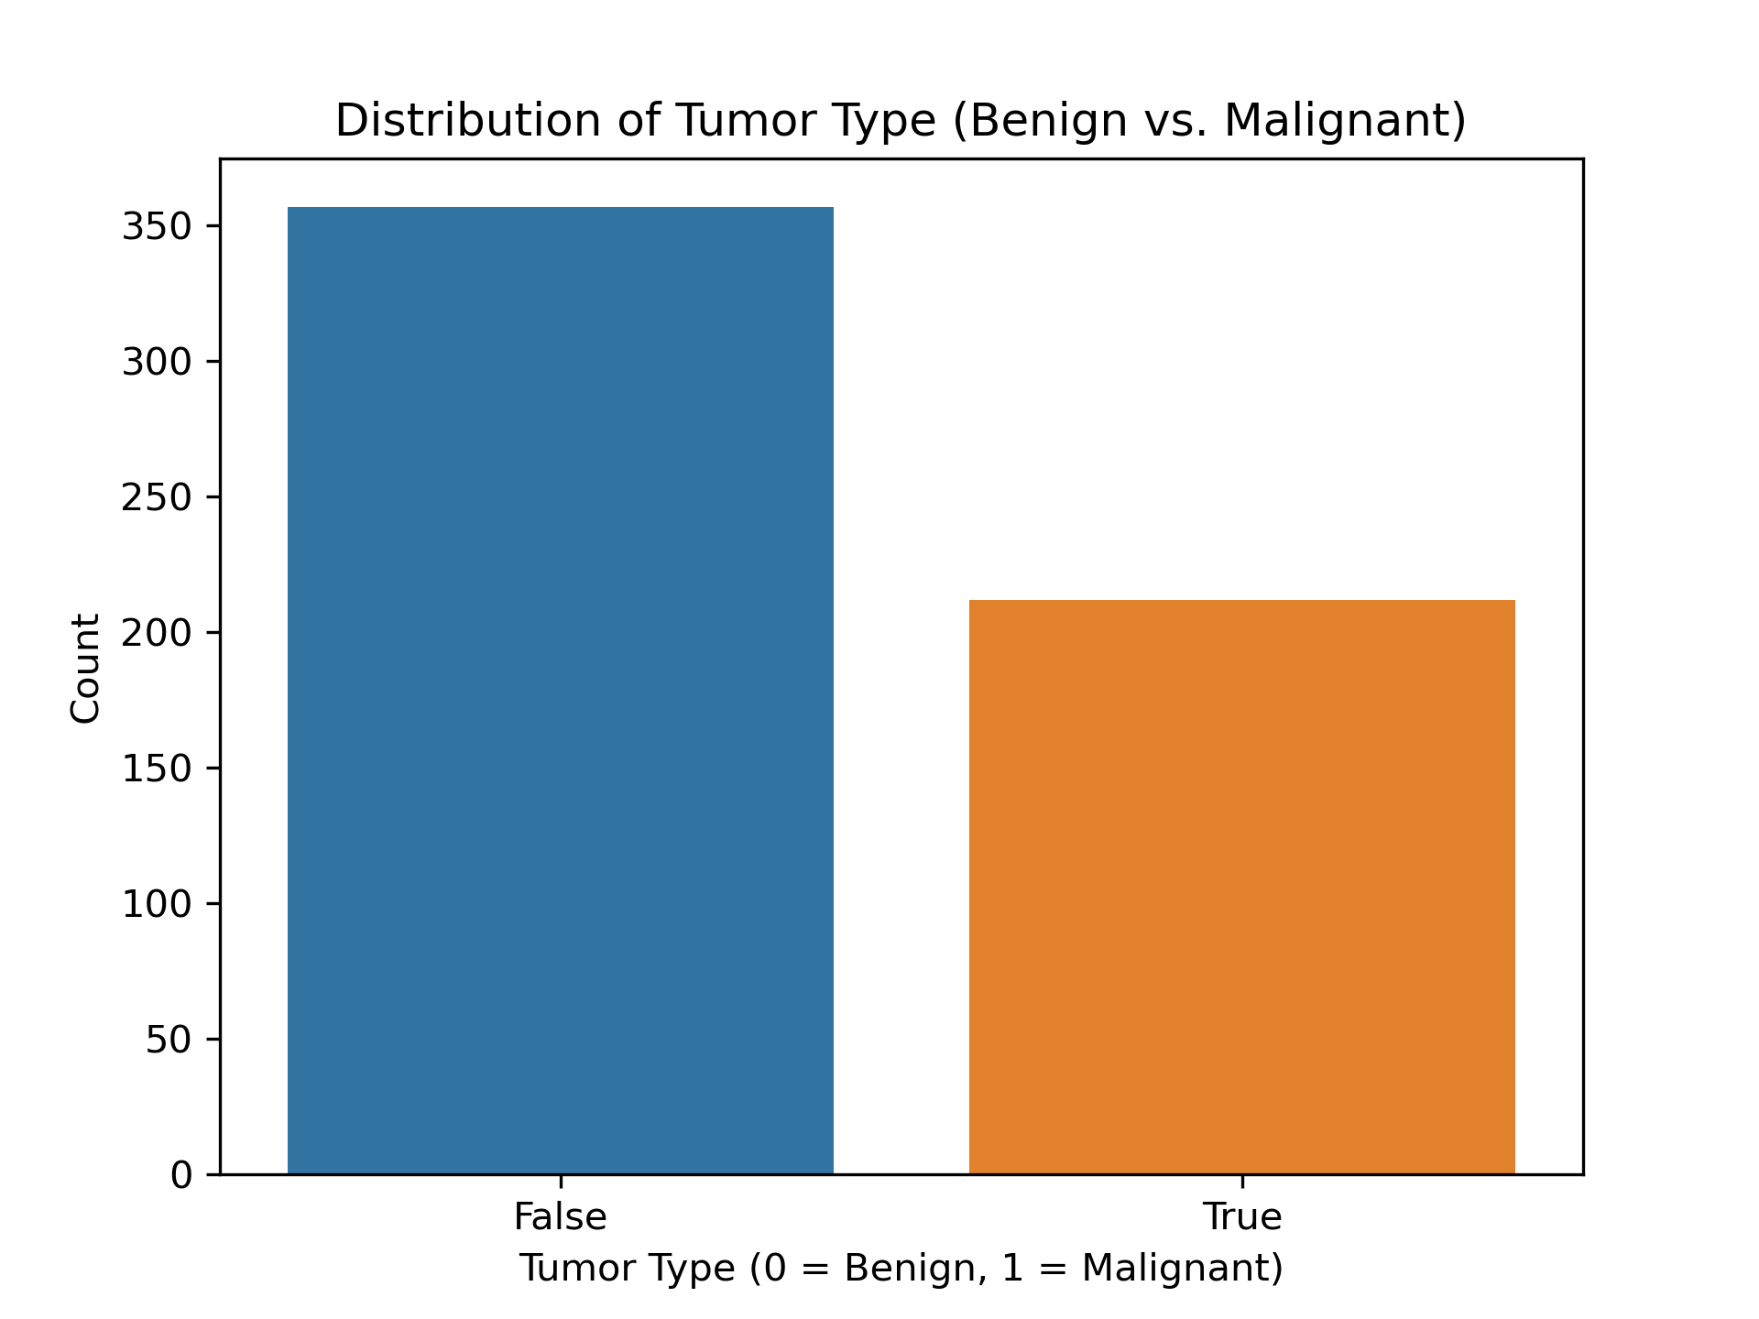
Analysis
Countplot distribution (around 200 malignant, 350 benign)

Slide 7
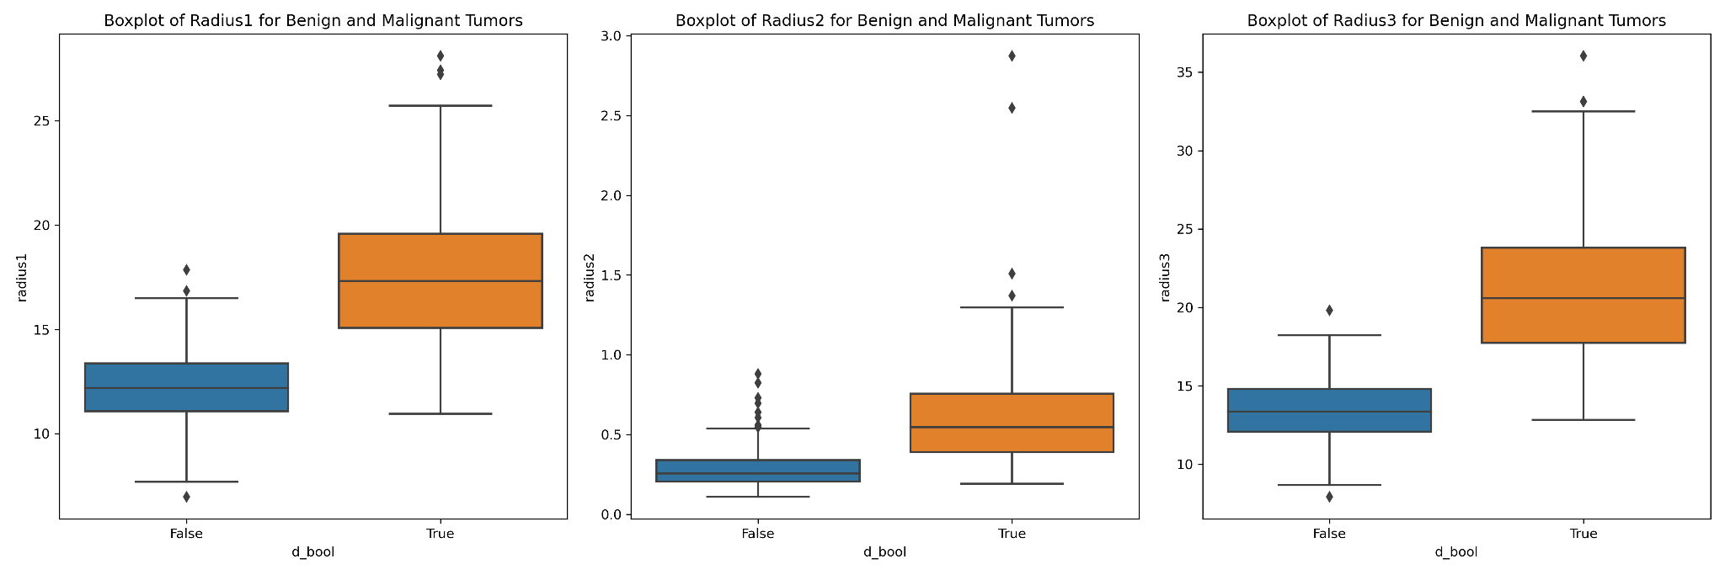
Analysis Cont.
Malignant tumors tumors generally had larger radius, perimeter, and area values

Slide 8
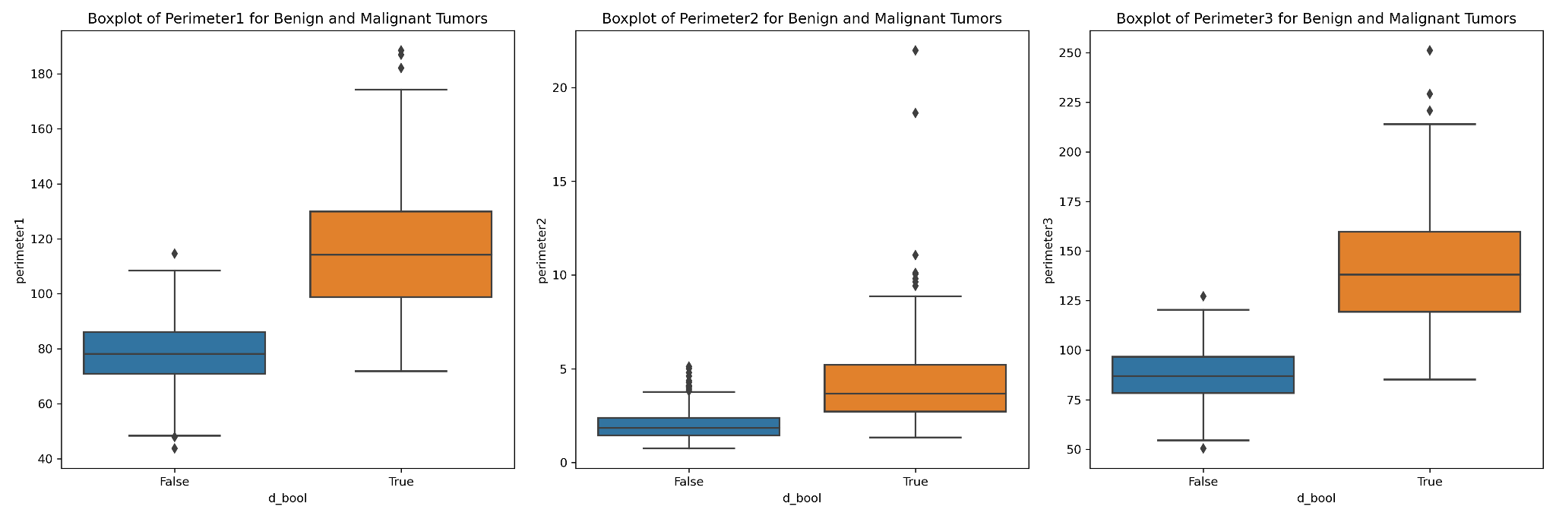
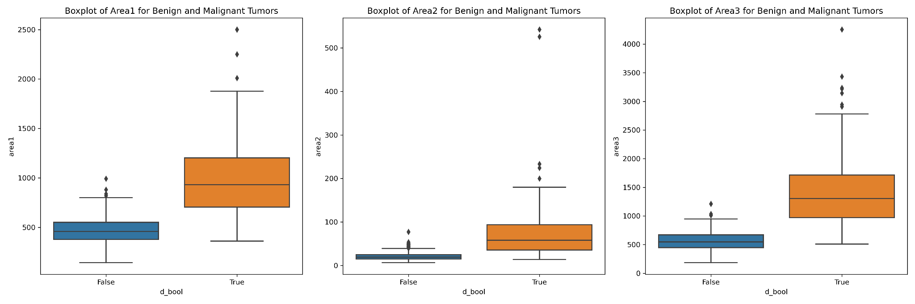
Analysis Cont.

Slide 9
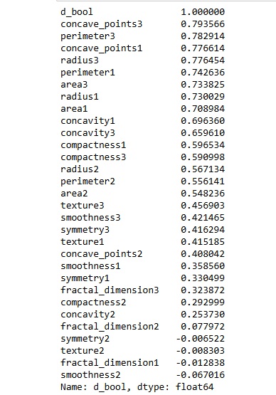
Correlation Matrix
Strongest correlations: concave_points3, perimeter3, radius3, concave_points1
Weakest correlations: symmetry2, texture2

Slide 10
Model Performance
Accuracy for 80/20 split: Logistic Regression: 96.49%, Random Forest: 93.86%, SVM: 96.49%
Accuracy for 70/30 split: Logistic Regression: 97.66%, Random Forest: 95.91%, SVM: 97.08%
5-fold cross-validation boosted logistic regression accuracy to 97.74%

Slide 11
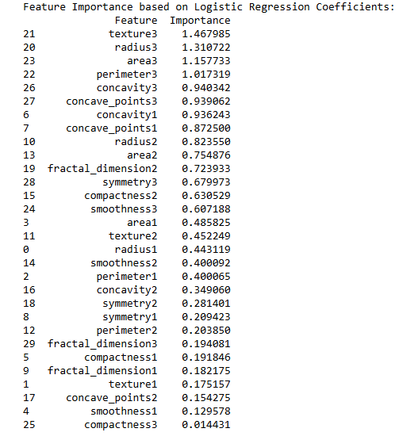
Feature Importance
Most important features: texture3, radius3, area3, perimeter3
Least important: compactness3, smoothness1

Slide 12
Conclusion
Tumor cell nuclei characteristics (size, shape, texture) are key indicators
Logistic regression model showed highest accuracy
Provides a robust framework for future diagnosis applications

Slide 13
Assumptions and Limitations
Future Uses and Applications
No significant assumptions
Dataset size (569 records) could be limiting for more complex analysis
No major challenges encountered
Expanding the dataset would improve analysis
Aim for 98-99% accuracy in future models
Potential for real-world applications in medical diagnosis

Slide 14
Recommendations
Ethical Assessment
Increase record size to strengthen model
Leverage AI for improved accuracy and decision-making
Dataset was ethically sourced
No personal data included
No significant ethical concerns

Slide 15
Thank You
Thank you for your attention.
Any Questions?

